Slide 1
Management Plan:
5 Year Action Plan Progress points
Year 4
Year 5
Year 3
Year 2
Year 1

Slide 2
Year 1 Progress
2024
Biodiversity
Overall: 21%
16 actions 4 part complete 12 pending
Visitors
Overall: 26%
15 actions 6 part complete 9 pending
Community
Overall: 54%
8 actions 1 complete 4 part complete 3 pending
Landscape
Overall: 29%
3 actions 1 part complete 2 pending
Heritage
Overall: 61%
5 actions 5 part complete
Health & Recreation
Overall: 38%
2 actions 1 part complete 1 pending

Slide 3
Biodiversity
Visitors
Community
Landscape
Heritage
Health & Recreation

Slide 4
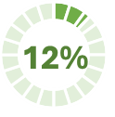
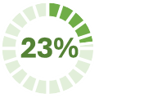
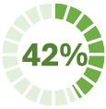
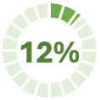
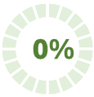
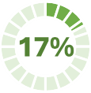
1 action: 1.9
Monitor
5 actions: 1.1 1.2 1.3 1.4 1.5
Maintain
Biodiversity
Inform
1 action: 1.10
Manage
2 actions: 1.11 1.12
Invasives
3 actions: 1.6 1.7 1.8
Protect
4 actions: 1.13 1.14 1.15 1.16

Slide 5
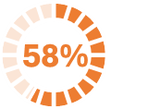
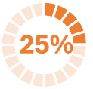
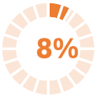
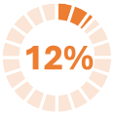
2 actions: 2.1 2.10
Monitoring
3 actions: 2.3 2.7 2.12
Promote
Visitors
2 actions: 2.4 2.5
Quality
Inform
4 actions: 2.6 2.8 2.9 2.11
Safety
4%
2 actions: 2.2 2.13

Slide 6
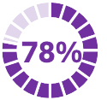
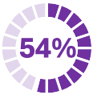
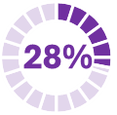
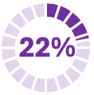
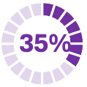
2 actions: 3.1 3.2
Quality
2 actions: 3.3 3.7
Events
Community
Promote
2 actions: 3.5 3.6
Educate
1 action: 3.4
My River
1 action: 3.8

Slide 7
2 actions: 4.1 4.3
Planning
Landscape
Photographic record
1 actions: 4.2

Slide 8
3 actions: 5.1 5.2 5.3
Giants Ring
Heritage
Lock Keeper’s & Barge
2 actions: 5.4 5.5

Slide 9
1 action: 6.1
Data capture
Health & Recreation
Support activities
1 action: 6.2

